Slide 1
Accumulator
CSE 429: DSD

Slide 2
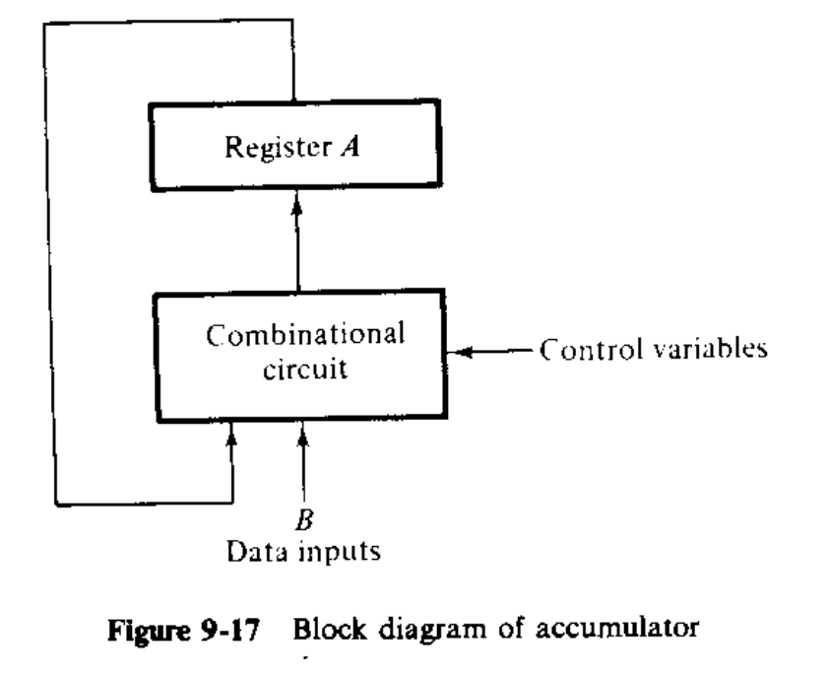
Design of Accumulator
Essentially a bidirectional shift register with parallel load
Connected to the ALU
Accumulator refers to both the A register and its associated combinational circuit
Multifunctional, performs all of the micro-operations in a processor unit.
B register is assumed to be connected to the accumulator

Slide 3
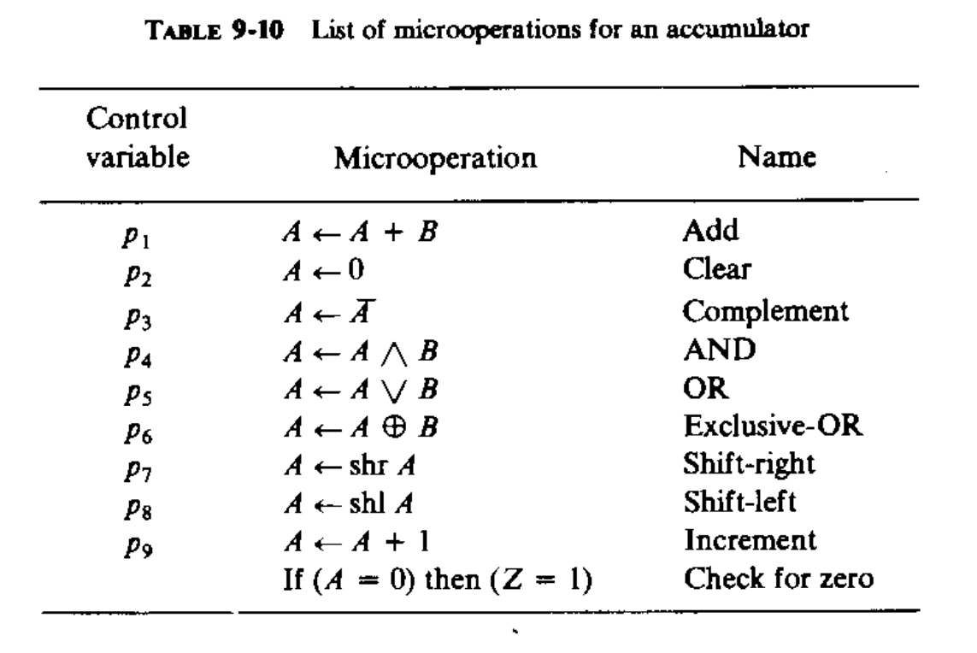
Control Variables
New information transferred to A constitutes the next state of the sequential circuit.
Nine control variables- inputs, mutually exclusive, only one variable enabled when a clock pulse occurs.

Slide 4
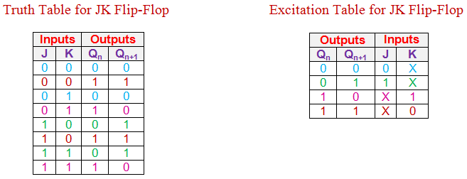
Design Procedure
n stages and n flip-flops, A₁, A₂, …., A_{n}
Each stage A_{i} is interconnected with the stage on right and left.
Designed using JK flip flops

Slide 5
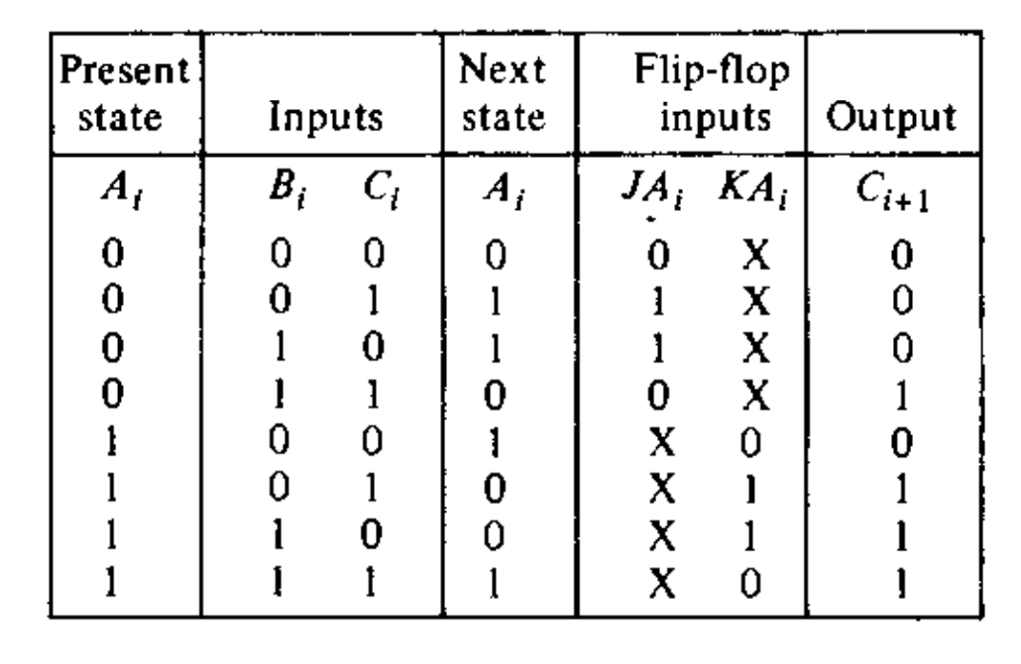

P₁ : A + B
$JA_{i }= B_{i}C_{i}′p_{1}+ B_{i}′C_{i}p_{1}$
$KA_{i }= B_{i}C_{i}′p_{1}+ B_{i}′C_{i}p_{1}$
$C_{i+1 }= A_{i}B_{i}+ A_{i}C_{i}+B_{i}C_{i}$

Slide 6

P₂ : Clear A
For clear: J-K = 0, 1
$JA_{i }=0$
$KA_{i }= p_{2}$

Slide 7

P₃ : Complement
For complement: J-K = 1, 1
$JA_{i }=p_{3}$
$KA_{i }= p_{3}$

Slide 8
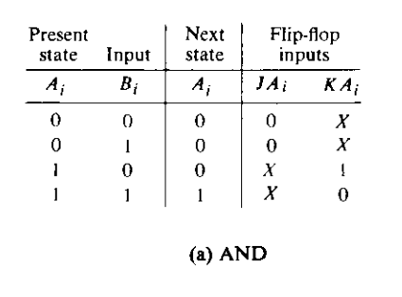

P₄ : AND
$JA_{i }=0$
$KA_{i }=B_{i}′p_{4}$

Slide 9
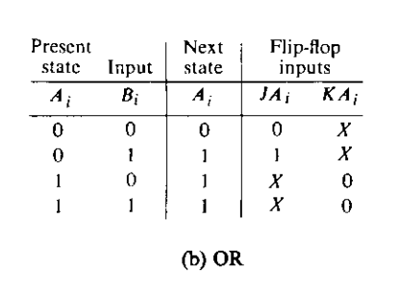

P₅ : OR
$JA_{i }=B_{i}p_{5}$
$KA_{i }=0$

Slide 10
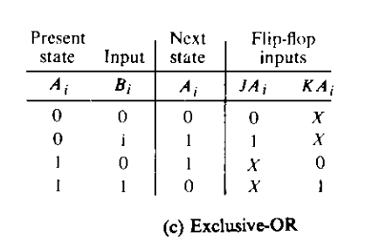

P₆ : Exclusive-OR
$JA_{i }=B_{i}p_{6}$
$KA_{i }=B_{i}p_{6}$

Slide 11

P₇ : Shift-Right
$JA_{i }=A_{i+1}p_{7}$
$KA_{i }=A_{i+1}′p_{7}$
Current A_{i} | A_{i+1} | Next A_{i} | JA_{i} | KA_{i}
0 | 0 | 0 | 0 | X
0 | 1 | 1 | 1 | X
1 | 0 | 0 | X | 1
1 | 1 | 1 | X | 0

Slide 12

P₈ : Shift-Left
$JA_{i }=A_{i−1}p_{8}$
$KA_{i }=A_{i−1}′p_{8}$
Current A_{i} | A_{i-1} | Next A_{i} | JA_{i} | KA_{i}
0 | 0 | 0 | 0 | X
0 | 1 | 1 | 1 | X
1 | 0 | 0 | X | 1
1 | 1 | 1 | X | 0

Slide 13
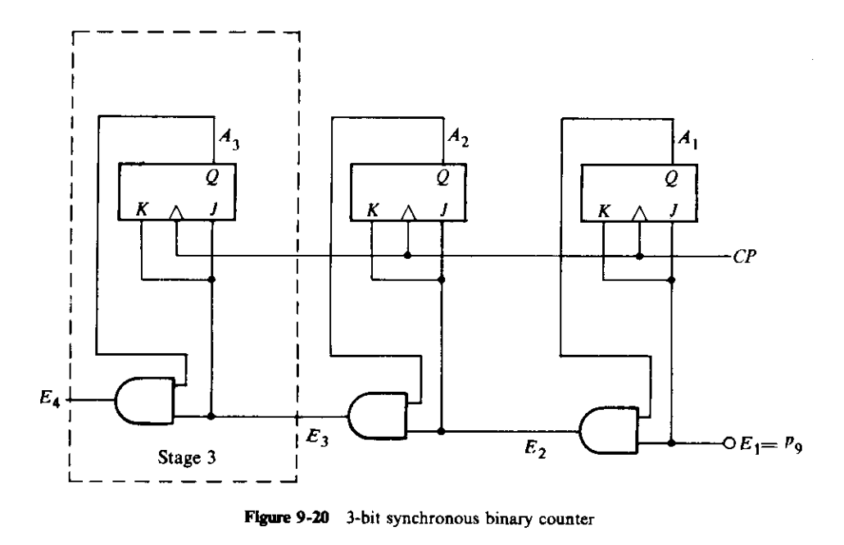

P₉ : Increment
Current A_{i} | E_{i} | Next A_{i} | E_{i+1} | JA_{i} | KA_{i}
0 | 0 | 0 | 0 | 0 | X
0 | 1 | 1 | 0 | 1 | X
1 | 0 | 1 | 0 | X | 0
1 | 1 | 0 | 1 | X | 1
$JA_{i }=E_{i}$
$KA_{i }=E_{i}$
$E_{i+1 }=E_{i}A_{i}$
$E_{1 }=p_{9}$

Slide 14
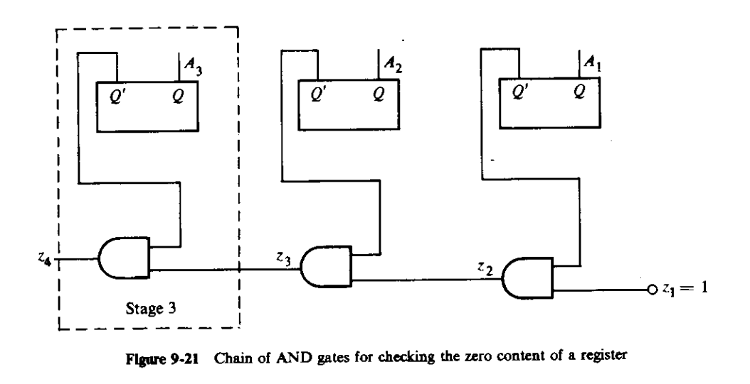

Check for zero
$z_{i+1 }=z_{i}A_{i}′$
$z_{1 }=1$
$z_{n+1 }=Z$

Slide 15

One stage of Accumulator
$JA_{i }= B_{i}C_{i}′p_{1}+ B_{i}′C_{i}p_{1}+ p_{3}+ B_{i}p_{5}+ B_{i}p_{6}+ A_{i+1}p_{7}+ A_{i−1}p_{8}+ E_{i}$
$KA_{i }= B_{i}C_{i}′p_{1}+ B_{i}′C_{i}p_{1}{+p}_{2}{+p}_{3}+ B_{i}′p_{4}+ B_{i}p_{6}+ A_{i+1}′p_{7}+ A_{i−1}′p_{8}+ E_{i}$
$C_{i+1 }= A_{i}B_{i}+ A_{i}C_{i}+B_{i}C_{i}$
$E_{i+1 }= E_{i}A_{i}$
$z_{i+1 }= z_{i}A_{i}′$

Slide 16
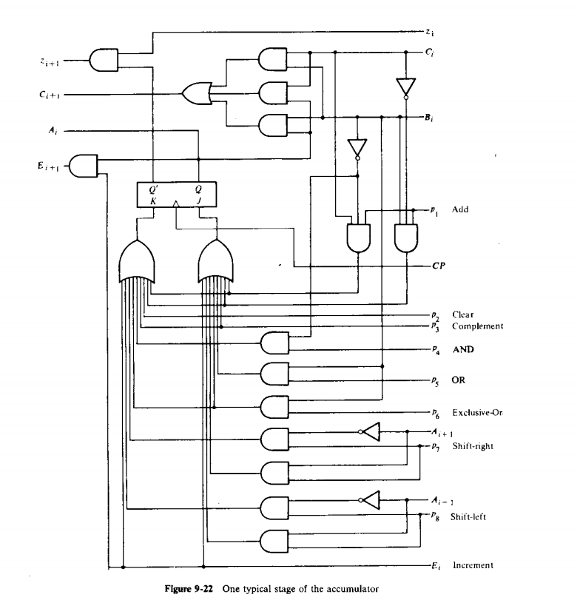
One stage of Accumulator

Slide 17
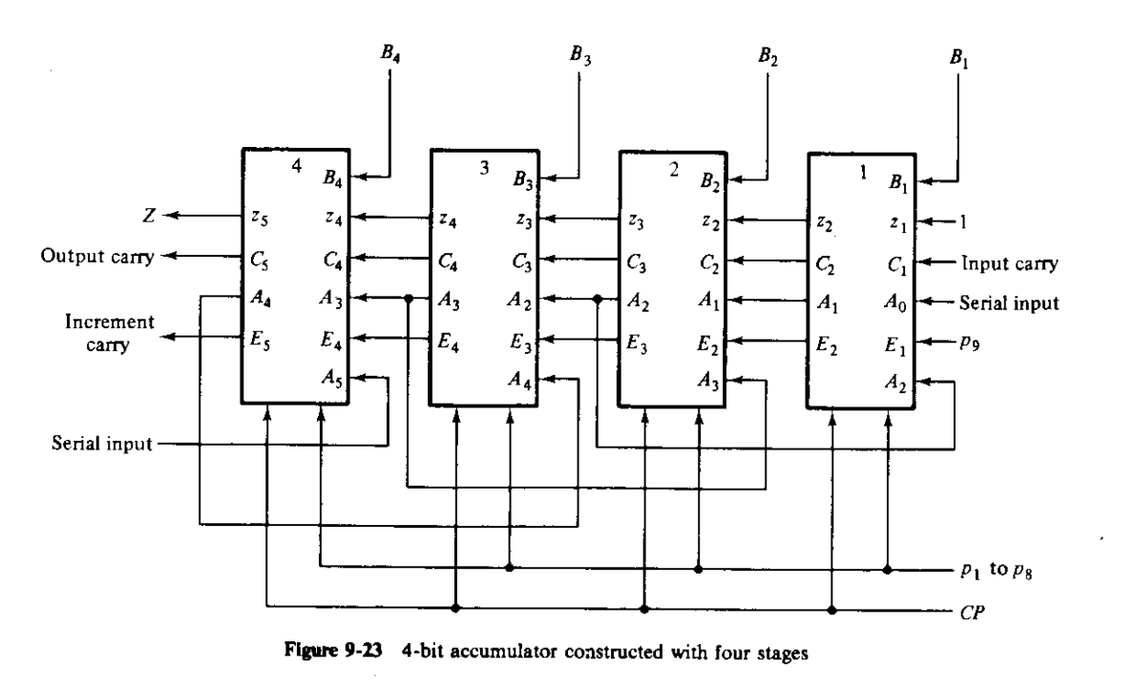
Complete Accumulator

Slide 18

Practice
P1: A ← A – B
P2: A ← all 1
P3: A ← $\overline{A⋁B}$ (NOR)
P4: A ← $\overline{A⋀B}$(NAND)
P5: A ← A xnor B
P6: A ← A – 1 (Decrement)
P7: A ← $\overline{A}+1$ (2’s complement form)

Slide 19
A – B
Solution 1: With Borrow
Here Bo₁ = 0
Current A_{i} | B_{i} | Bo_{i} | Next A_{i} | Bo_{i+1}
0 | 0 | 0 | 0 | 0
0 | 0 | 1 | 1 | 1
0 | 1 | 0 | 1 | 1
0 | 1 | 1 | 0 | 1
1 | 0 | 0 | 1 | 0
1 | 0 | 1 | 0 | 0
1 | 1 | 0 | 0 | 0
1 | 1 | 1 | 1 | 1

Slide 20
A – B
Solution 2: We can rewrite A – B as A + B’ + 1
Here C₁ = 1
Current A_{i} | B_{i}’ | C_{i} | Next A_{i} | C_{i+1}
0 | 0 | 0 | 0 | 0
0 | 0 | 1 | 1 | 0
0 | 1 | 0 | 1 | 0
0 | 1 | 1 | 0 | 1
1 | 0 | 0 | 1 | 0
1 | 0 | 1 | 0 | 1
1 | 1 | 0 | 0 | 1
1 | 1 | 1 | 1 | 1

Slide 21
A – 1
With borrow as D_{i} and D₁ = 1
Current A_{i} | D_{i} | Next A_{i} | D_{i+1} | JA_{i} | KA_{i}
0 | 0 | 0 | 0 | 0 | X
0 | 1 | 1 | 1 | 1 | X
1 | 0 | 1 | 0 | X | 0
1 | 1 | 0 | 0 | X | 1

Slide 22
A’ + 1 (2s complement)
Same concept as increment, only we add the carry to A’ instead of A
Current A_{i} | A_{i}’ | E_{i} | Next A_{i} | E_{i+1}
0 | 1 | 0 | 1 | 0
0 | 1 | 1 | 0 | 1
1 | 0 | 0 | 0 | 0
1 | 0 | 1 | 1 | 0

